Slide 1


Setting Goals to be Perfect in 2026 Pt2 (Matthew 5:48)
Notes:
Eddie Williams ~ January 4, 2026

Slide 2
Matthew 5:48 (NASB)
Therefore you shall be perfect, as your heavenly Father is perfect.

Slide 3
PERFECT:
Mature
Full Grown
Strong Faith

Slide 4
Three Points on Perfection
Being Perfect Requires Loving Jesus More Than Family and Friends as well as Lukewarm Satan controlled Christians
Maturity Requires Loving Jesus More Than Money
To be Perfect in 2026, We Must Love Jesus More Than Self

Slide 5
Point #1: Being Perfect Requires Loving Jesus More Than Family and Friends as well as Lukewarm, Satan controlled Christians
Matthew 10:32-39 (NASB)
II Timothy 2:22-26 (NASB)
Matthew 16:21-23 (NASB)
Deuteronomy 13:1-11 (NASB)

Slide 6
Matthew 10:32-39 (NASB)
³² "Therefore, everyone who confesses Me before people, I will also confess him before My Father who is in heaven.
³³ "But whoever denies Me before people, I will also deny him before My Father who is in heaven.

Slide 7
Matthew 10:32-39 (NASB)
³⁴ "Do not think that I came to bring peace on the earth; I did not come to bring peace, but a sword. ³⁵ "For I came to TURN A MAN AGAINST HIS FATHER, AND A DAUGHTER AGAINST HER MOTHER, AND A DAUGHTER-IN-LAW AGAINST HER MOTHER-IN-LAW;

Slide 8
Matthew 10:32-39 (NASB)
³⁶ and A PERSON'S ENEMIES WILL BE THE MEMBERS OF HIS HOUSEHOLD. ³⁷ "The one who loves father or mother more than Me is not worthy of Me; and the one who loves son or daughter more than Me is not worthy of Me.

Slide 9
Matthew 10:32-39 (NASB)
³⁸ "And the one who does not take his cross and follow after Me is not worthy of Me.
³⁹ "The one who has found his life will lose it, and the one who has lost his life on My account will find it.

Slide 10
II Timothy 2:22-26 (NASB)
²² Now flee from youthful lusts and pursue righteousness, faith, love, and peace with those who call on the Lord from a pure heart. ²³ But refuse foolish and ignorant speculations, knowing that they produce quarrels.

Slide 11
II Timothy 2:22-26 (NASB)
²⁴ The Lord's bond-servant must not be quarrelsome, but be kind to all, skillful in teaching, patient when wronged,
²⁵ with gentleness correcting those who are in opposition,

Slide 12
II Timothy 2:22-26 (NASB)
if perhaps God may grant them repentance leading to the knowledge of the truth, ²⁶ and they may come to their senses and escape from the snare of the devil, having been held captive by him to do his will.

Slide 13
Matthew 16:21-23 (NASB)
²¹ From that time Jesus began to point out to His disciples that it was necessary for Him to go to Jerusalem and to suffer many things from the elders, chief priests, and scribes, and to be killed, and to be raised up on the third day.

Slide 14
Matthew 16:21-23 (NASB)
²² And yet Peter took Him aside and began to rebuke Him, saying, "God forbid it, Lord! This shall never happen to You!"

Slide 15
Matthew 16:21-23 (NASB)
²³ But He turned and said to Peter, "Get behind Me, Satan! You are a stumbling block to Me; for you are not setting your mind on God's purposes, but men's."

Slide 16
Deuteronomy 13:1-11 (NASB)
¹ "If a prophet or a dreamer of dreams arises among you and gives you a sign or a wonder, ² and the sign or the wonder comes true, of which he spoke to you, saying, 'Let's follow other gods (whom you have not known) and let's serve them,'

Slide 17
Deuteronomy 13:1-11 (NASB)
³ you shall not listen to the words of that prophet or dreamer of dreams; for the LORD your God is testing you to find out whether you love the LORD your God with all your heart and with all your soul.

Slide 18
Deuteronomy 13:1-11 (NASB)
⁴ "You shall follow the LORD your God and fear Him; and you shall keep His commandments, listen to His voice, serve Him, and cling to Him.
⁵ "But that prophet or that dreamer of dreams shall be put to death,

Slide 19
Deuteronomy 13:1-11 (NASB)
because he has spoken falsely against the LORD your God who brought you out of the land of Egypt and redeemed you from the house of slavery, to drive you from the way in which the LORD your God commanded you to walk.

Slide 20
Deuteronomy 13:1-11 (NASB)
So you shall eliminate the evil from among you. ⁶ "If your brother, your mother's son, or your son or daughter, or the wife you cherish, or your friend who is like your own soul, entices you secretly, saying,

Slide 21
Deuteronomy 13:1-11 (NASB)
'Let's go and serve other gods' (whom neither you nor your fathers have known, ⁷ of the gods of the peoples who are around you, near you, or far from you, from one end of the earth to the other end),

Slide 22
Deuteronomy 13:1-11 (NASB)
⁸ you shall not consent to him or listen to him; and your eye shall not pity him, nor shall you spare or conceal him. ⁹ "Instead, you shall most certainly kill him; your hand shall be first against him to put him to death,

Slide 23
Deuteronomy 13:1-11 (NASB)
and afterward the hand of all the people. ¹⁰ "So you shall stone him to death, because he has attempted to drive you away from the LORD your God who brought you out of the land of Egypt, out of the house of slavery.

Slide 24
Deuteronomy 13:1-11 (NASB)
¹¹ "Then all Israel will hear about it and be afraid, and will not do such a wicked thing among you again.

Slide 25
Point #2: Maturity Requires Loving Jesus More Than Money
Matthew 6:24 (NASB)
Malachi 1:6-10 (NASB)

Slide 26
Matthew 6:24 (NASB)
No one can serve two masters; for either he will hate the one and love the other, or he will be devoted to one and despise the other.
You cannot serve God and wealth.

Slide 27
We cannot serve two masters because, as Jesus pointed out, we end up hating one and loving the other. It’s only natural. Opposing masters demand different things and lead down different paths. The Lord is headed in one direction, and our flesh and the world are headed in the other.

Slide 28
A choice must be made.
When we follow Christ, we must die to everything else. We will be like some of the seeds in Jesus’ parable (Luke 8:5–15)—only a portion of those seeds actually bore fruit. Some sprouted at first but then withered and died. They were not deeply rooted in good soil.

Slide 29
If we attempt to serve two masters, we will have divided loyalties, and, when the difficulties of discipleship clash with the lure of fleshly pleasure, the magnetic pull of wealth and worldly success will draw us away from Christ (see 2 Timothy 4:10).

Slide 30
The call to godliness goes against our sinful nature. Only with the help of the Holy Spirit can we remain devoted to one Master (John 6:44).

Slide 31
Malachi 1:6-10 (NASB)
⁶ "'A son honors his father, and a servant his master. Then if I am a father, where is My honor? And if I am a master, where is My respect?' says the LORD of armies to you, the priests who despise My name!

Slide 32
Malachi 1:6-10 (NASB)
But you say, 'How have we despised Your name?’ ⁷ "You are presenting defiled food upon My altar. But you say, 'How have we defiled You?' In that you say, 'The table of the LORD is to be despised.'

Slide 33
Malachi 1:6-10 (NASB)
⁸ "And when you present a blind animal for sacrifice, is it not evil? Or when you present a lame or sick animal, is it not evil? So offer it to your governor! Would he be pleased with you, or would he receive you kindly?" says the LORD of armies.

Slide 34
Malachi 1:6-10 (NASB)
⁹ "But now, do indeed plead for God's favor, so that He will be gracious to us. With such an offering on your part, will He receive any of you kindly?" says the LORD of armies.

Slide 35
Malachi 1:6-10 (NASB)
¹⁰ "If only there were one among you who would shut the gates, so that you would not kindle fire on My altar for nothing! I am not pleased with you," says the LORD of armies, "nor will I accept an offering from your hand.

Slide 36
Point #3: To be Perfect in 2026, We Must Love Jesus More Than Self
Matthew 16:24-27 (NASB)
Luke 22:42 (NASB)
Galatians 2:20 (NASB)

Slide 37
Matthew 16:24-27 (NASB)
²⁴ Then Jesus said to His disciples, "If anyone wants to come after Me, he must deny himself, take up his cross, and follow Me.
²⁵ "For whoever wants to save his life will lose it;

Slide 38
Matthew 16:24-27 (NASB)
but whoever loses his life for My sake will find it.
²⁶ "For what good will it do a person if he gains the whole world, but forfeits his soul?

Slide 39
Matthew 16:24-27 (NASB)
Or what will a person give in exchange for his soul? ²⁷ "For the Son of Man is going to come in the glory of His Father with His angels, and WILL THEN REPAY EVERY PERSON ACCORDING TO HIS DEEDS.

Slide 40
Luke 22:42 (NASB)
saying,
"Father, if You are willing, remove this cup from Me; yet not My will, but Yours be done."

Slide 41
Galatians 2:20 (NASB)
I have been crucified with Christ; and it is no longer I who live, but Christ lives in me; and the life which I now live in the flesh I live by faith in the Son of God, who loved me and gave Himself up for me.

Slide 42
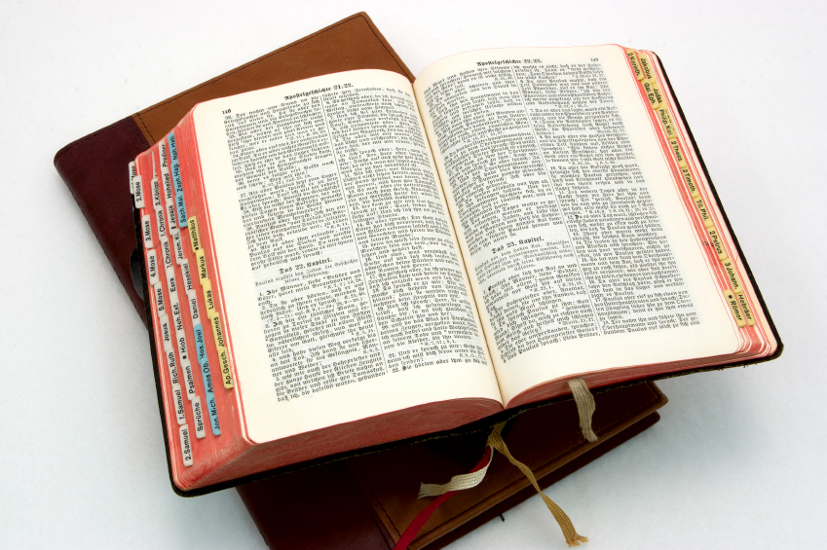
Hear: Romans 10:17
So then faith cometh by hearing, and hearing by the word of God.

Slide 43
Believe: Hebrews 11:6
But without faith it is impossible to please him: for he that cometh to God must believe that he is, and that he is a rewarder of them that diligently seek him.

Slide 44
Repent: Luke 13:3
I tell you, Nay: but, except ye repent, ye shall all likewise perish.

Slide 45
Confess: Matthew 10:32-33
32 Whosoever therefore shall confess me before men, him will I confess also before my Father which is in heaven.
33 But whosoever shall deny me before men, him will I also deny before my Father which is in heaven.

Slide 46
Baptize: Acts 22:16
And now why tarriest thou? arise, and be baptized, and wash away thy sins, calling on the name of the Lord.

